Slide 1
Database systems I
Lecture Three

Slide 2
Relational Model
The relational model is an approach to logically represent and manage the data stored in a database. In this model, the data is organized into a collection of two-dimensional inter-related tables, also known as relations. Each relation is a collection of columns and rows, where the column represents the attributes of an entity and the rows (or tuples) represents the records.
The use of tables to store the data provided a straightforward, efficient, and flexible way to store and access structured information. The relational model is today the primary data model for commercial data processing applications. It attained its primary position because of its simplicity, which eases the job of the programmer, compared to earlier data models such as the network model or the hierarchical model.

Slide 3
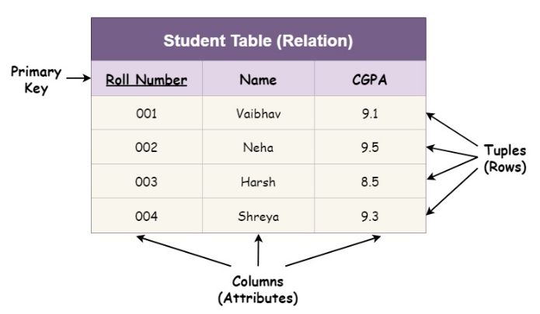
Relational Model
Let's look at a scenario to understand the relational model:

Slide 4
RDBMS
The software used to store, manage, query, and retrieve data stored in a relational database is called a relational database management system (RDBMS). The RDBMS provides an interface between users and applications and the database, as well as administrative functions for managing data storage, access, and performance.
Some popular Relational Database management systems are:
  MYSQL
  Oracle
  IBM DB2,
  Microsoft SQL Server database

Slide 5
Relational Model Concepts
As discussed earlier, a relational database is based on the relational model. This database consists of various components based on the relational model. These include:
Relation : Two-dimensional table used to store a collection of data elements.
Tuple : Row of the relation, depicting a real-world entity.
Attribute/Field : Column of the relation, depicting properties that define the relation.
Attribute Domain : Set of pre-defined atomic values that an attribute can take i.e., it describes the legal values that an attribute can take.

Slide 6
Relational Model Concepts
Degree : It is the total number of attributes present in the relation.
Cardinality : It specifies the number of entities involved in the relation i.e., it is the total number of rows present in the relation.
Relational Schema : It is the logical blueprint of the relation i.e., it describes the design and the structure of the relation. It contains the table name, its attributes, and their types:
For the Student relation example, the relational schema will be:
STUDENT(ROLL_NUMBER INTEGER, NAME VARCHAR(20), CGPA FLOAT)

Slide 7
Relational Model Concepts
Relational Instance : It is the collection of records present in the relation at a given time.
Relation Key : It is an attribute or a group of attributes that can be used to uniquely identify an entity in a table or to determine the relationship between two tables. Relation keys include:
  Candidate Key
  Super Key
  Composite Key
  Primary Key

Slide 8
Data Integrity
Data integrity refers to the overall accuracy, completeness, and reliability of data.
Integrity constraints in Database Management Systems (DBMS) are a set of rules that are applied on the table columns or relationships to ensure that the overall validity, integrity, and consistency (i.e. the quality) of the data present in the database table is maintained.
Every time a table insert, update, delete, or alter operation is performed, it is evaluated against the terms or rules mentioned in the integrity constraint. The data is inserted, updated, deleted, or altered only if the result of the constraint comes out to be True.
Thus, integrity constraint prevents accidental damage to the database by an authorized user.

Slide 9
Types of Data Integrity
The following categories of data integrity exist with each RDBMS −
Entity Integrity − Entity Integrity Constraint is used to ensure the uniqueness of each record or row in the data table. There are primarily two types of integrity constraints that help us in ensuring the uniqueness of each row, namely, UNIQUE constraint and PRIMARY KEY constraint.
The unique key helps in uniquely identifying a record in the data table. It can be considered somewhat similar to the Primary key as both of them guarantee the uniqueness of a record. But unlike the primary key, a unique key can accept NULL values and it can be used on more than one column of the data table.

Slide 10
Types of Data Integrity
Domain Integrity − Domain integrity is the collection of processes that ensure the accuracy of each piece of data in a domain. In this context, a domain is a set of acceptable values that a column is allowed to contain.
A domain integrity constraint is a set of rules that restricts the kind of attributes or values a column or relation can hold in the database table. For example, we can specify if a particular column can hold null values or not, if the values have to be unique or not, the data type or size of values that can be entered in the column, the default values for the column, etc.
For example, when creating a “customer_details” table, with information such as customer id, customer name, the number of items purchased, date of purchase, etc. So, in order to ensure domain integrity, we can specify the customer_id has to be unique, the quantity of items purchased has to be an integer number only and the date of purchase has to be a date or timestamp, etc.

Slide 11
Data Integrity
Referential integrity − Referential Integrity Constraint ensures that there always exists a valid relationship between two tables. This makes sure that if a foreign key exists in a table relationship then it should always reference a corresponding value in the second table or it should be null.
User-Defined Integrity − User-defined integrity involves the rules and constraints created by the user to fit their particular needs. Sometimes entity, referential, and domain integrity aren’t enough to safeguard data. Often, specific business rules must be taken into account and incorporated into data integrity measures.

Slide 12
KEYS IN DATABASE
A key refers to an attribute/a set of attributes that help us identify a row (or tuple) uniquely in a table (or relation). The individual values present in a key are commonly referred to as key values.
Why we need a Key
Here are some reasons for using key in the DBMS system.
  Keys help you to identify any row of data in a table. In a real-world application, a table could contain thousands of records. Moreover, the records could be duplicated. Keys ensure that you can uniquely identify a table record despite these challenges.
  A key is also used when we want to establish relationships between the different columns and tables of a relational database
  Help in enforcing entity and referential integrity in the relationship.

Slide 13
Types of Keys in Database Management System
There are mainly six different types of Keys in DBMS and each key has a different functionality:
  Primary Key
  Super Key
  Candidate Key
  Alternate Key
  Foreign Key
  Compound key

Slide 14
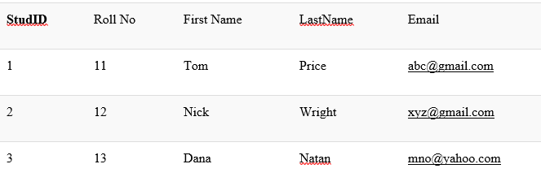
1. Super key
A super key is a set of one or more attributes (columns), which can uniquely identify a row in a table. It means that all of these columns present in a table that can identify the columns of that table uniquely act as the super keys.

Slide 15
2. Primary Key
  The primary key refers to a column or a set of columns of a table that helps us identify all the records uniquely present in that table.
  A table can consist of just one primary key.
  All the values of a primary key have to be unique, and there should be no repetitions.
  Also, Primary Key cannot contain null values

Slide 16
3. Candidate Key
  The candidate keys refer to those attributes that identify rows uniquely in a table. In a table, we select the primary key from a candidate key.
  Thus, a candidate key has similar properties as that of the primary keys that we have explained above. In a table, there can be multiple candidate keys.
  A super key is a candidate key’s superset

Slide 17
4. Alternate Keys
  As we have stated above, any table can consist of multiple choices for the primary key (candidate keys). But, it can only choose one. Thus, all those keys that did not become a primary key are known as alternate keys.

Slide 18
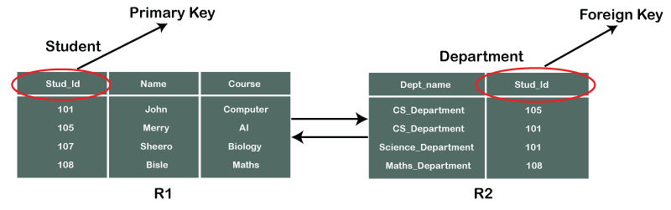
5. Foreign key
It is a column that creates a relationship between two tables.
The purpose of Foreign keys is to maintain data integrity and allow navigation between two different instances of an entity.
It acts as a cross-reference between two tables as it references the primary key of another table.
Example:

Slide 19
6. Compound Key
It has two or more attributes that allow you to uniquely recognize a specific record. It is possible that each column may not be unique by itself within the database. However, when combined with the other column or columns the combination of composite keys become unique.
The purpose of the compound key in database is to uniquely identify each record in the table.

Slide 20
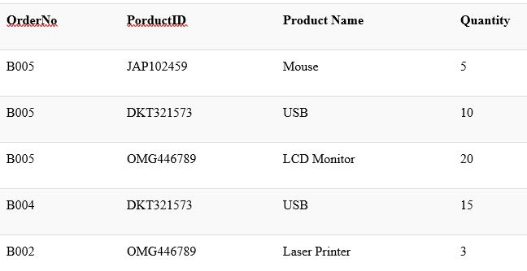
6. Compound Key continuation
Example: Consider the table below
In this example, OrderNo and ProductID can't be a primary key as it does not uniquely identify a record. However, a compound key of Order ID and Product ID could be used as it uniquely identified each record.

Slide 21
Advantages of using Relational Model
Simplicity: A Relational data model in DBMS is simpler than the hierarchical and network model.
Structural Independence: The relational database is only concerned with data and not with a structure. This can improve the performance of the model.
Easy to use: The Relational model in DBMS is easy as tables consisting of rows and columns are quite natural and simple to understand
Query capability: It makes possible for a high-level query language like SQL to avoid complex database navigation.
Scalable: Regarding a number of records, or rows, and the number of fields, a database should be enlarged to enhance its usability.

